Slide 1


Charge Injection System (CIS) Update
Katie Hughes, Dawit Belayneh
The University of Chicago
February 17, 2022

Slide 2
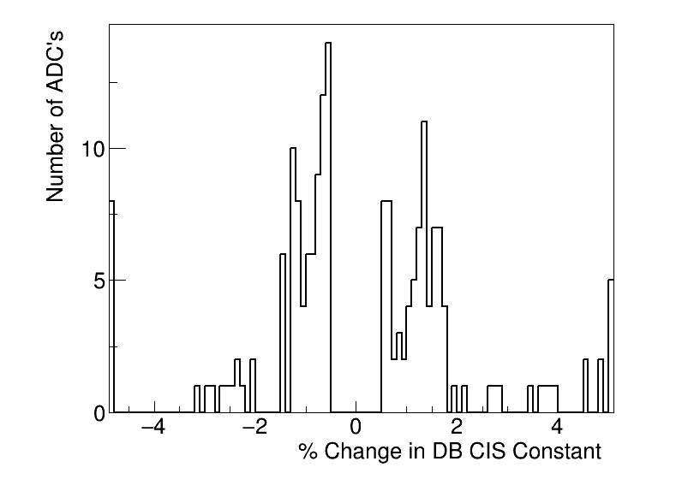
Summary
Updated Feb. 8
CIS runs from Jan. 16 - Jan. 31
191 channels in update
135 good
0 with >5% change
10 masked
46 affected
Notes:
Channels in update is much larger than usual (~125)

Slide 3
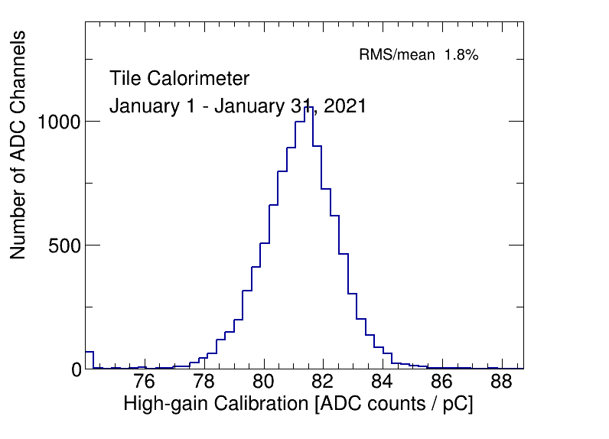
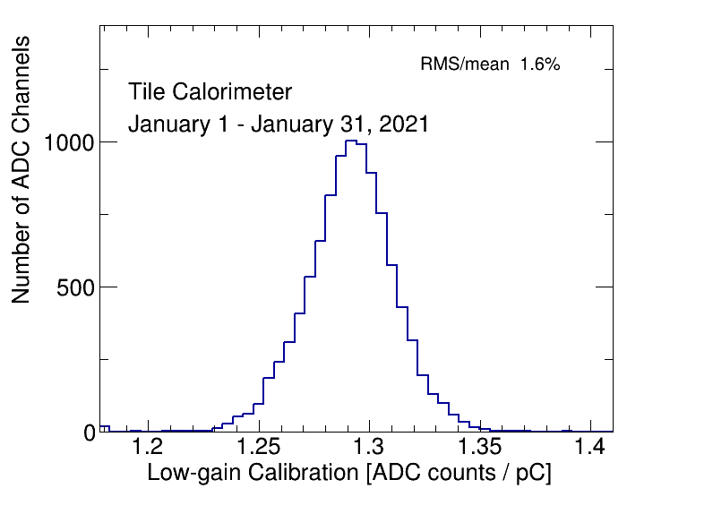
CIS constant distributions

Slide 4
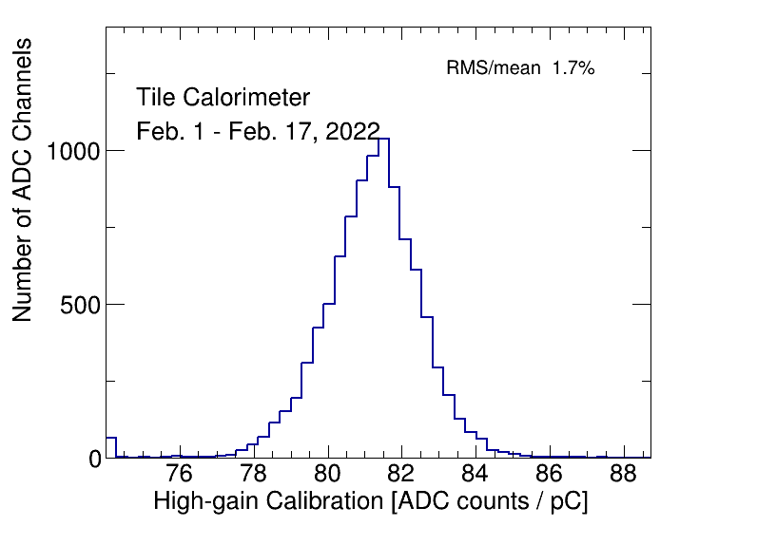
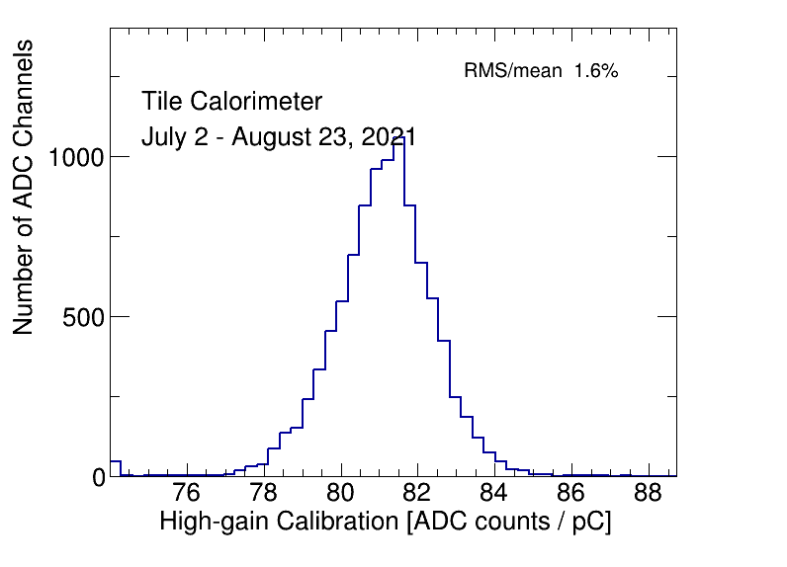
CIS constant distributions
Bump is still present in February.
Same bump only in HG has been present in previous CIS updates. Example:
I thought this could be because it may include BadCIS channels that were flagged incorrectly by TUCS, as we manually change some flags. But then why is it only present in HG distribution?

Slide 5
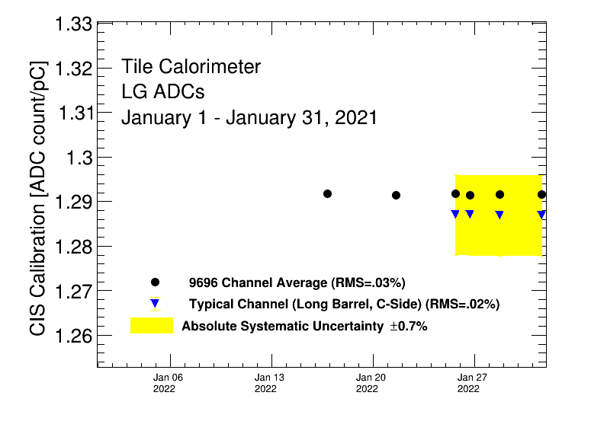
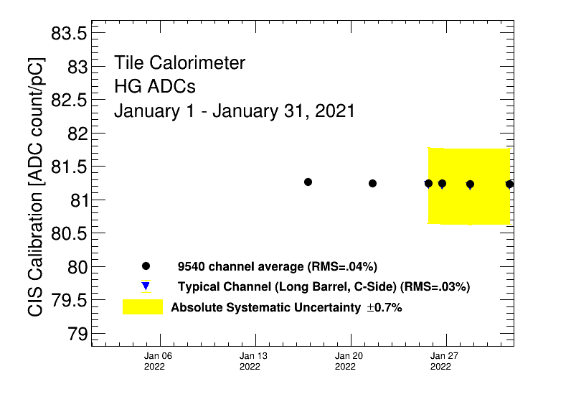
Detector stability

Slide 6
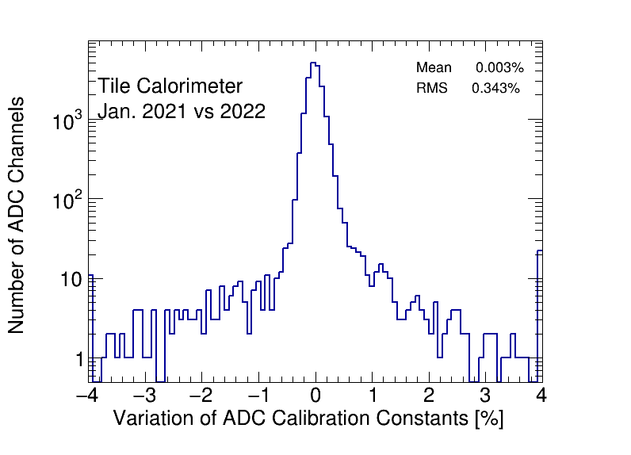
CIS constant stability

Slide 7
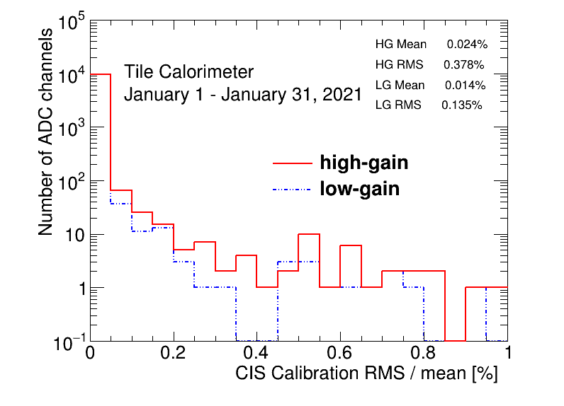
CIS constant RMS/mean

Slide 8
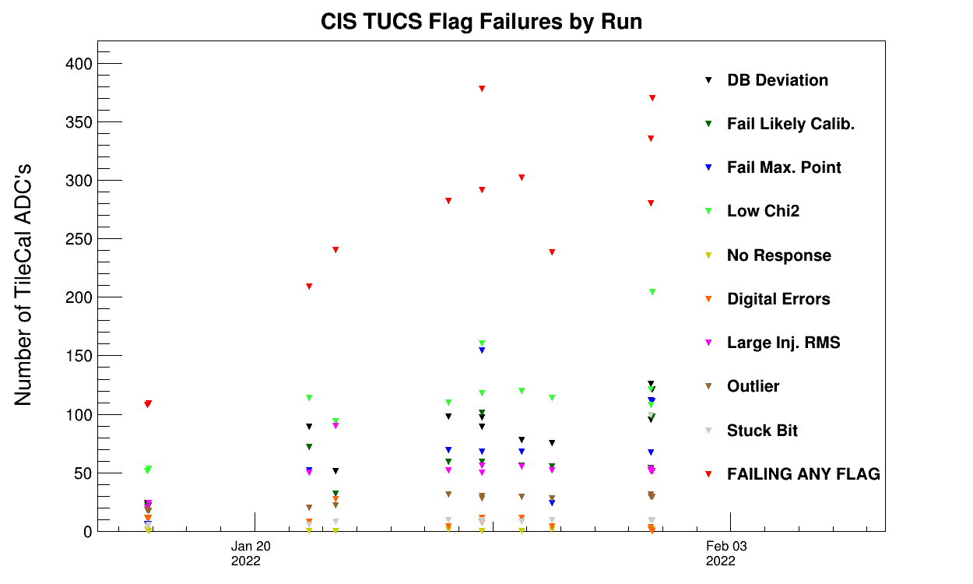
CIS TUCS Quality Flags

Slide 9
Interesting channel behaviour

Slide 10
Channels Far from Detector Avg
Highgain (Avg should be 81)
EBA_m06_c20_highgain: 74.55
EBA_m39_c31_highgain: 74.04
EBA_m50_c31_highgain: 71.58
EBC_m18_c36_highgain: 28.68
EBC_m23_c36_highgain: 69.28
EBC_m37_c40_highgain: 73.59
EBC_m43_c36-41: ~54
LBA_m62_c26_highgain: 10.14
LBC_m41_c25_highgain: 47.07
LBC_m52_c18_highgain: 103.88
LBC_m57_c06_highgain: 53.65
Lowgain (Avg should be 1.29)
LBC_m23_c20_lowgain: 1.69
EBC_m26_c01_lowgain: 0.18
EBC_m43_c36-41: ~0.86
EBC_m56_c41_lowgain: 1.16
All were also far from detector avg. in the last CIS update.

Slide 11
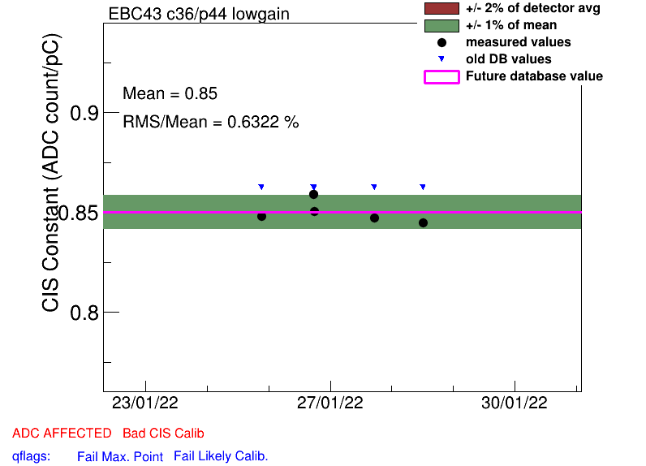
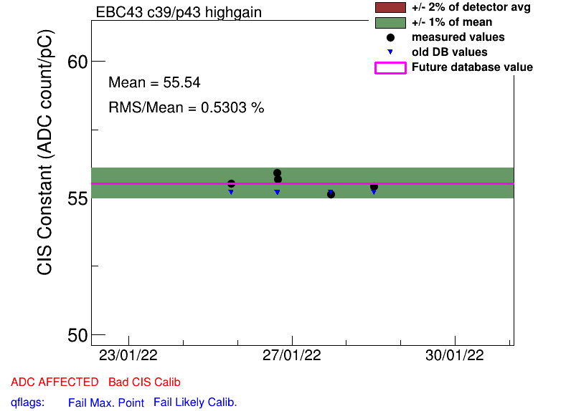
EBC_m43_c36-41
Unusually low and same pattern across all channels/both gains. Same issue in the last CIS update. Flagged as a problem in some DQ reports.

Slide 12
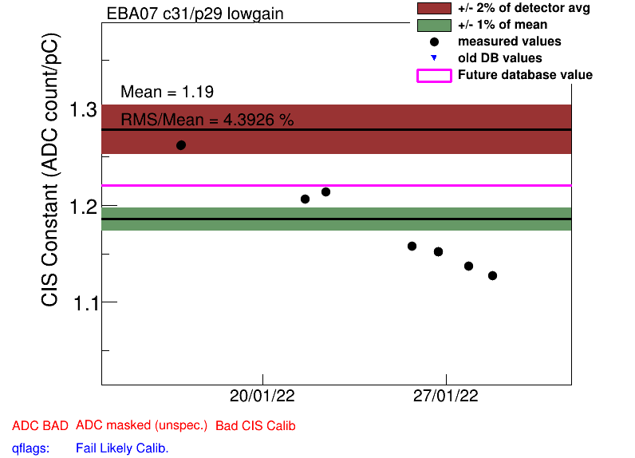
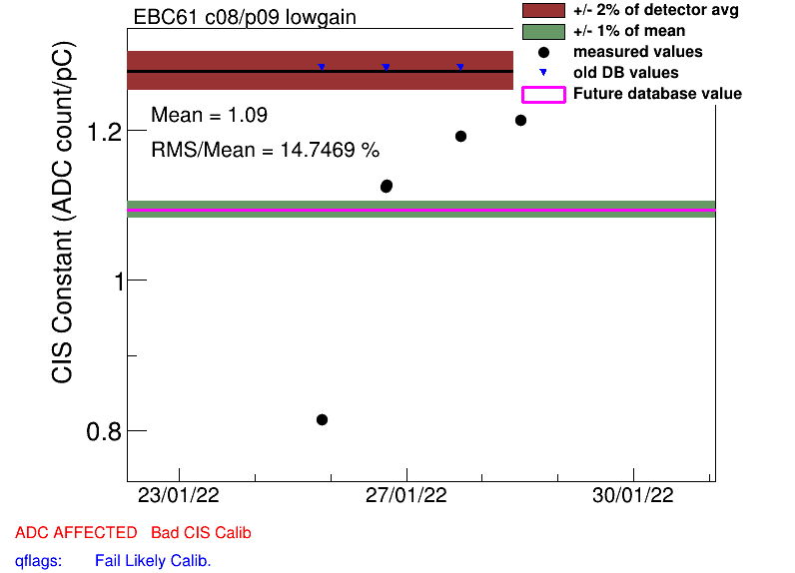
Some High Scatter Channels
EBA_m07_c31_lowgain
EBA_m42_c30_highgain
EBA_m49_c00_highgain
EBA_m50
EBC_m16_c39_highgain
EBC_m61_c08_lowgain
LBA_m02_c06
LBA_m03_c17_lowgain
LBA_m35_c08_highgain
LBA_m45_c06_highgain
LBA_m62_c26_highgain
LBC_m10_c37_highgain
LBC_m57_c06_highgain

Slide 13
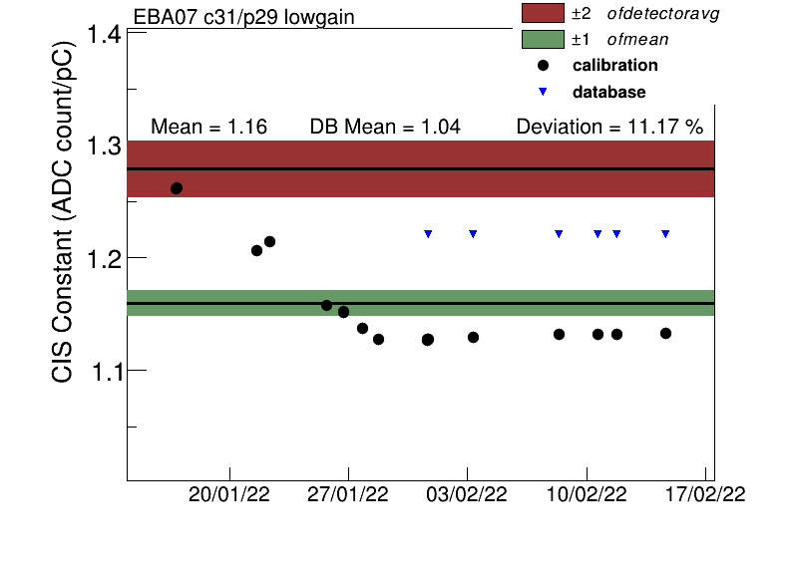
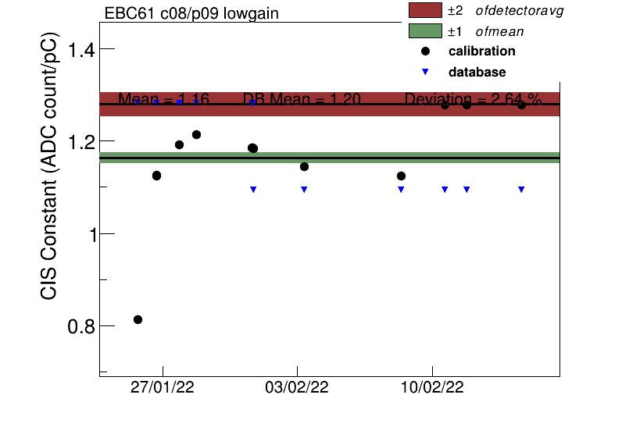
Update on Drifting Channels
Next DB update will be in 2 weeks
Stabilized around 1.13
Recently returned to detector avg.

Slide 14
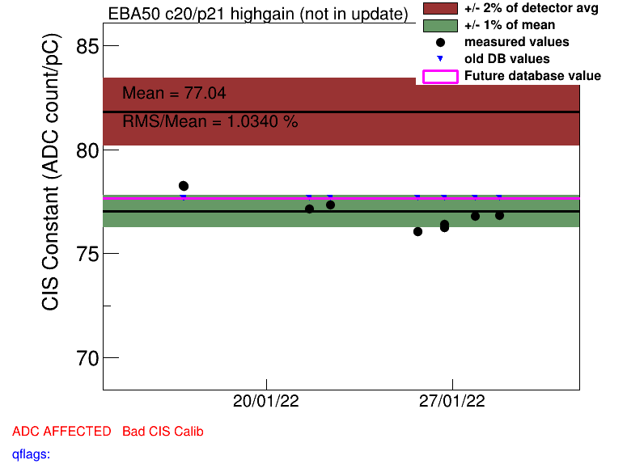
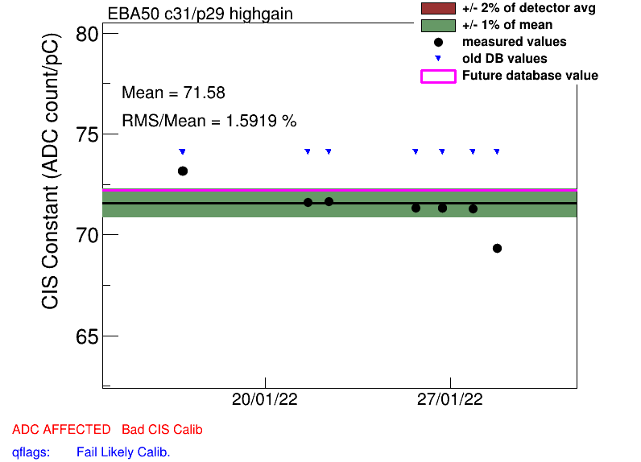
EBC_m50
Multiple channels have high scatter

Slide 15
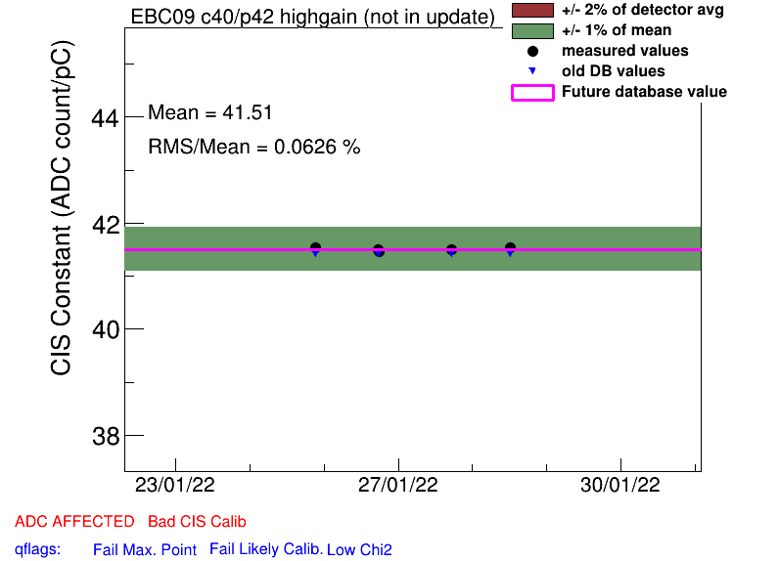
Half Gain Channels
EBA_m15_c08_highgain
EBA_m16_c00_highgain
EBA_m36_c15_highgain
EBA_m48_c31_lowgain
EBC_m09_c40_highgain
EBC_m18_c04_lowgain
EBC_m21_c36_lowgain
LBA_m37_c19_highgain
LBC_m08_c03_lowgain
LBC_m19_c22_lowgain
LBC_m47_c35_lowgain
All were also half gain in the last CIS update

Slide 16
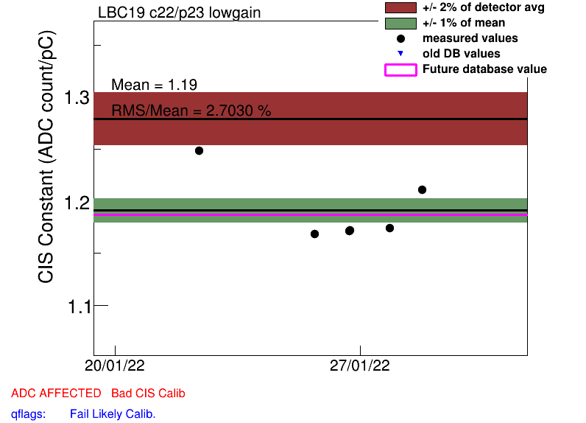
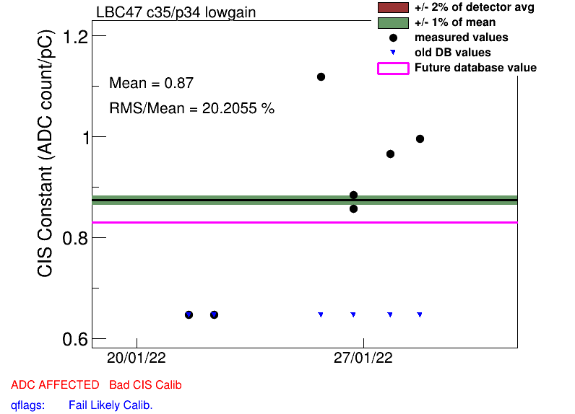
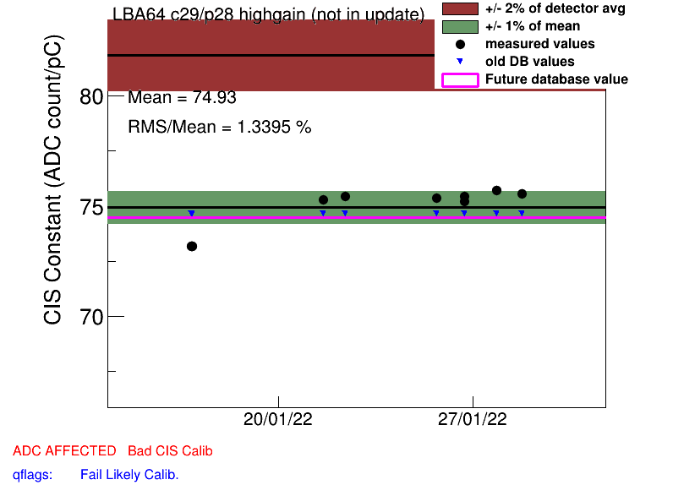
“Recovered” half gain channels
These 3 channels were at half gain last update, but are still unusually low / high scatter in this update

Slide 17
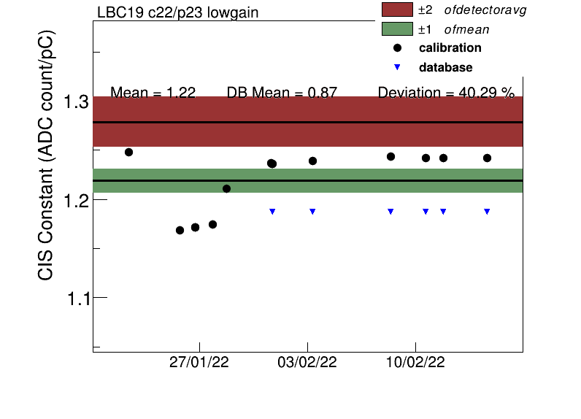
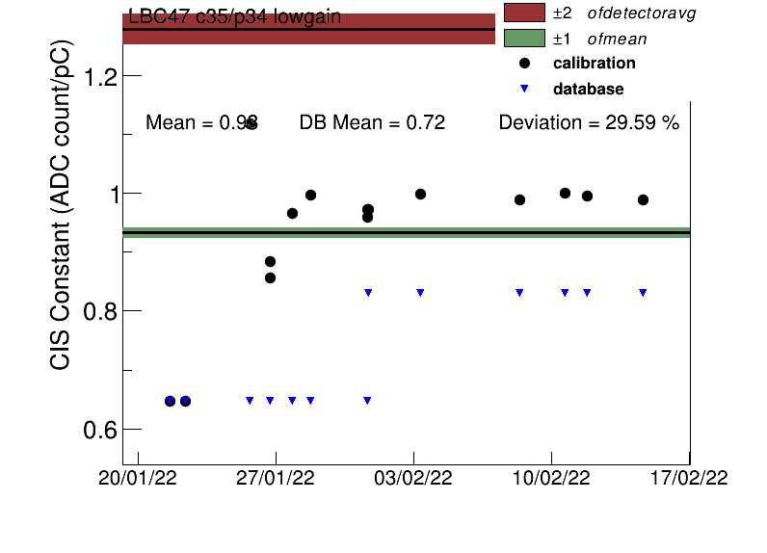
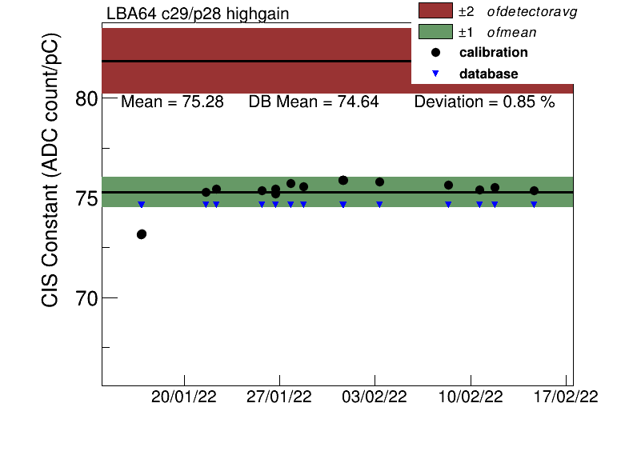
“Recovered” half gain channels: Update
This month, LBC_m19_c22_lowgain has returned close to detector avg. The other two have less scatter than last month, but are still unusually low.

Slide 18
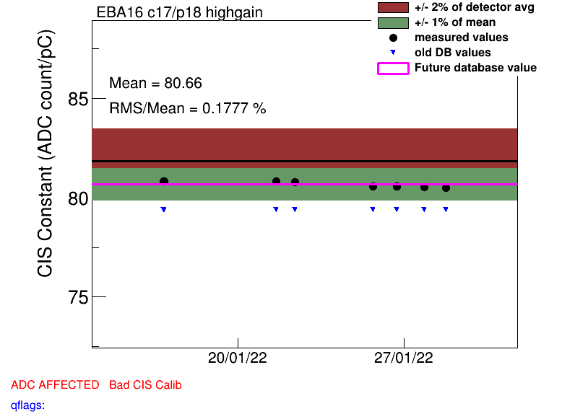
Some Channels with Constant Shifts
Jan. 24
EBA_m13_c04_lowgain
EBA_m16_c17_highgain
EBA_m28_c05_lowgain
EBA_m48_c37_highgain
EBA_m51_c00
LBA_m42_c07_highgain
All of these shifts are extremely small in magnitude.

Slide 19
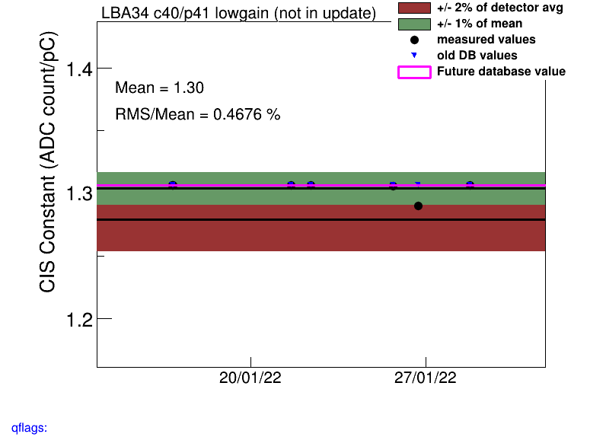
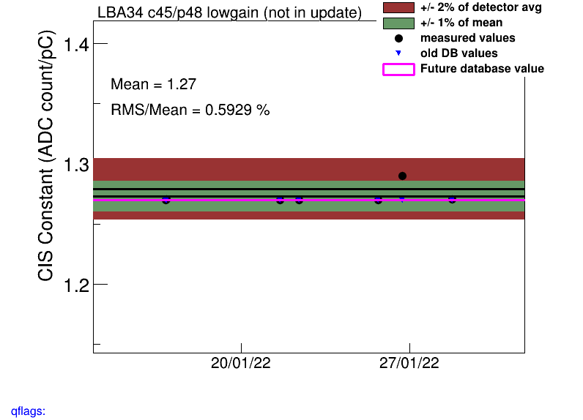
LBA34 lowgain
CIS run on 1/27 (409897) an outlier for all channels

Slide 20
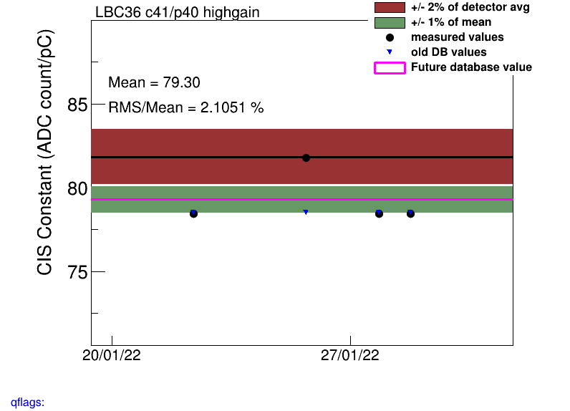
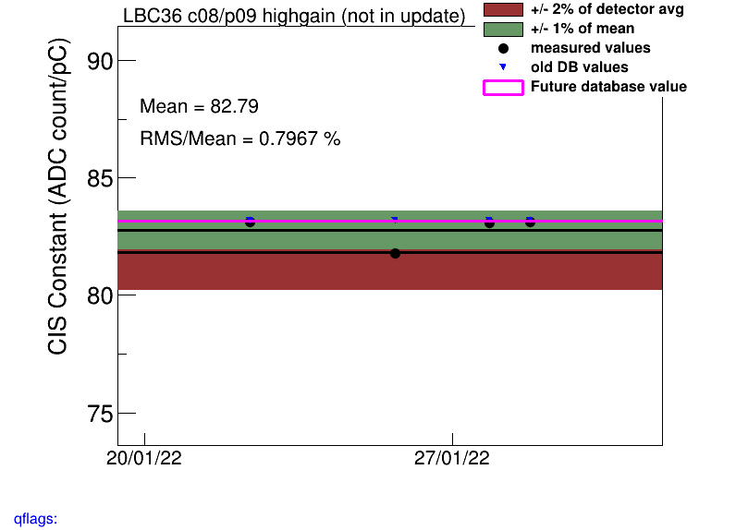
LBC36 highgain
One of the CIS runs on 1/26 (409752 or 409752?) an outlier for all channels

Slide 21
COOL Flag Updates
Remove BadCIS
EBA_m16_c17_highgain
EBA_m28_c05_lowgain
EBA_m48_c37_highgain
EBC_m15_c16_highgain
EBC_m16_c07_lowgain
EBC_m23_c01_lowgain
EBC_m30_c11_highgain
EBC_m30_c11_lowgain
EBC_m58_c31_highgain
EBC_m58_c31_lowgain
EBC_m63_c15_highgain
LBA_m21_c45_highgain
LBA_m42_c07_highgain
LBA_m57_c08_lowgain
LBA_m60_c29_lowgain
LBC_m04_c14_highgain
LBC_m49_c26_highgain
LBC_m49_c26_lowgain
LBC_m52_c34_highgain
LBC_m52_c34_lowgain
LBC_m59_c26_highgain
Add BadCIS
EBA_m19_c41_highgain
EBA_m55_c22_highgain
LBA_m06_c40_highgain
LBA_m13_c32_lowgain
LBC_m20_c37_highgain
LBC_m36_highgain
LBA_m34_lowgain

Slide 22
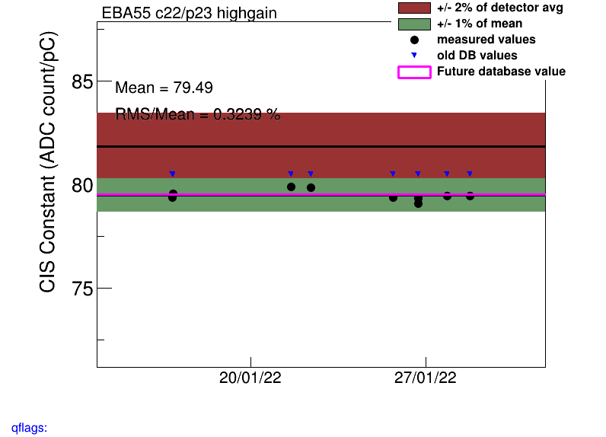
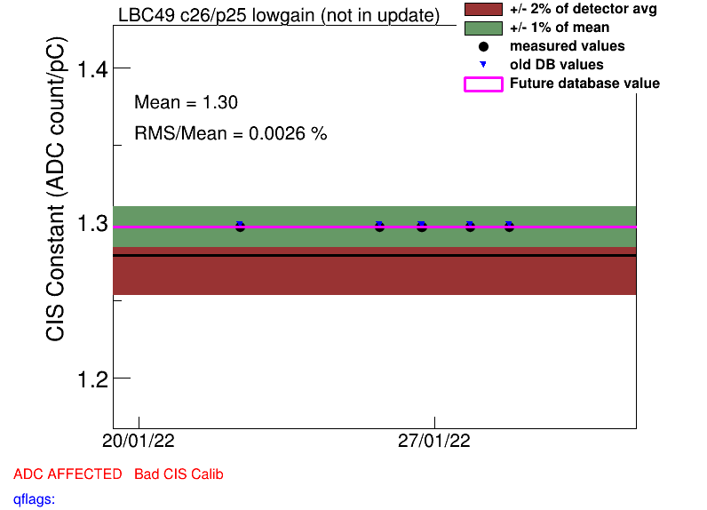
Remove BadCIS
Add BadCIS

Slide 23
